Slide 1
Project 2
Ames Housing Data and Kaggle Challenge

Slide 2

Data Science Problem
Identify most relevant features from Ames Housing Dataset
Create a regression model to predict the sale price of each house accurately
Submit to Kaggle for score
Recommendations on how to improve the home value

Slide 3

Procedure
Clean data
Conduct Exploratory Data Analysis (EDA)
Visualization diagrams (boxplot, histogram, regplot etc.) to discover patterns
Feature Engineering
Select most relevant features
4 regression models: Linear, Ridge, Lasso and Elastic Net

Slide 4
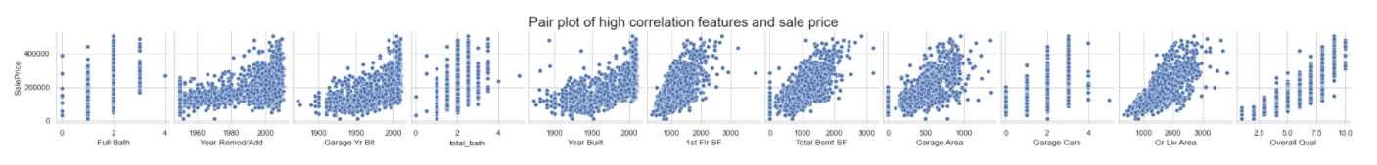
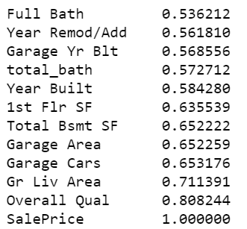
Numerical features
Numerical features > 0.5 correlation with sale price

Slide 5
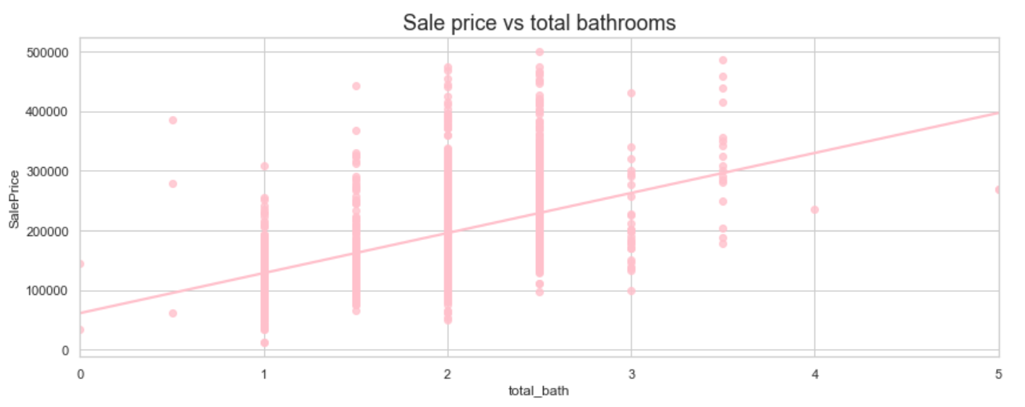
Feature Engineering
Total bathroom = full bathroom + 0.5 * half bathroom

Slide 6
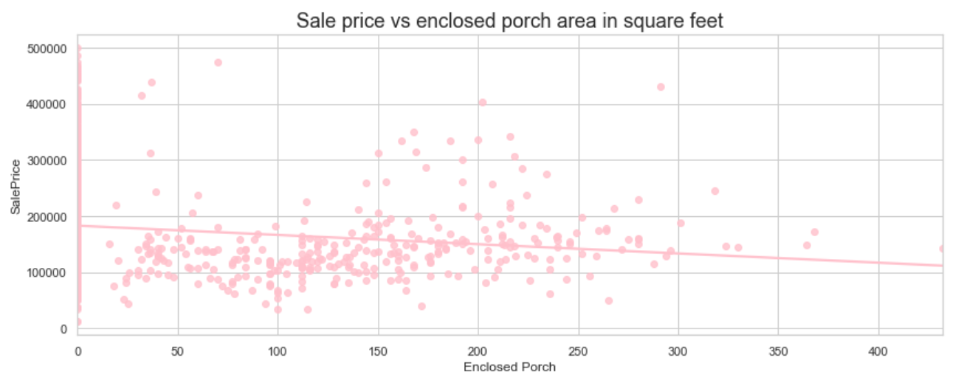
Negative correlation features

Slide 7
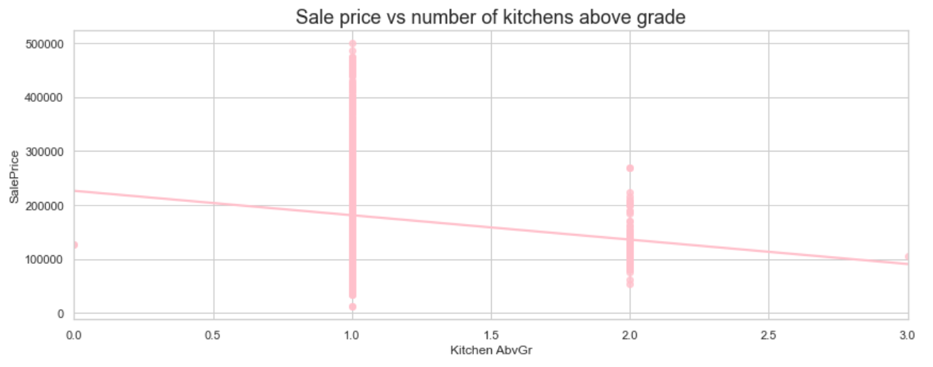
Negative correlation features

Slide 8
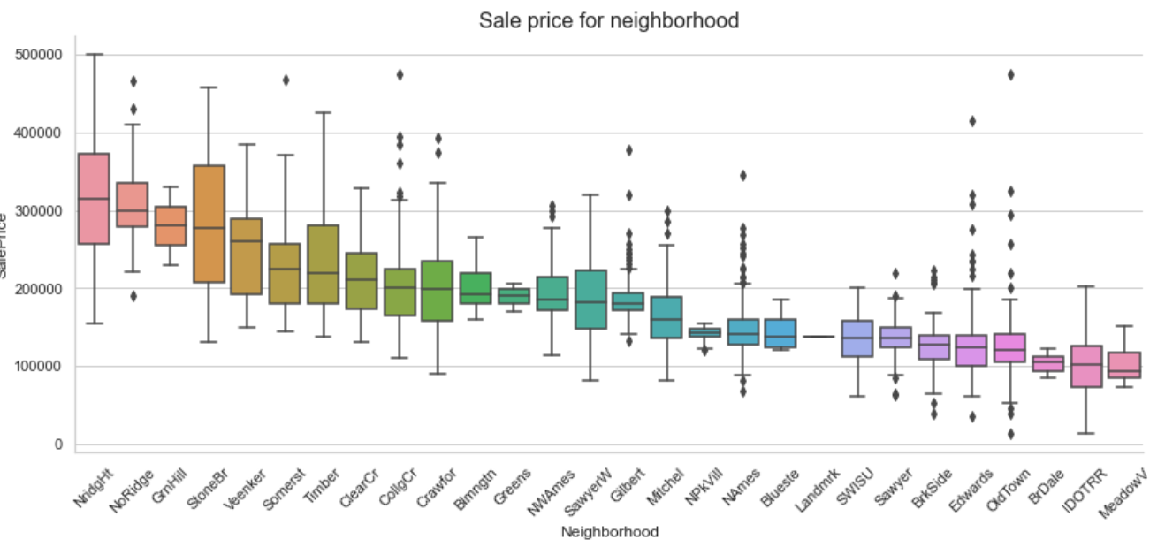
Categorical features
Notes:
Neighborhoods were grouped into 3 groups according to their median price : <= 166 633, <= 240 817, > 240 817.
Dummies variables were created for group 1 and group 2. Group 3 is the reference group

Slide 9
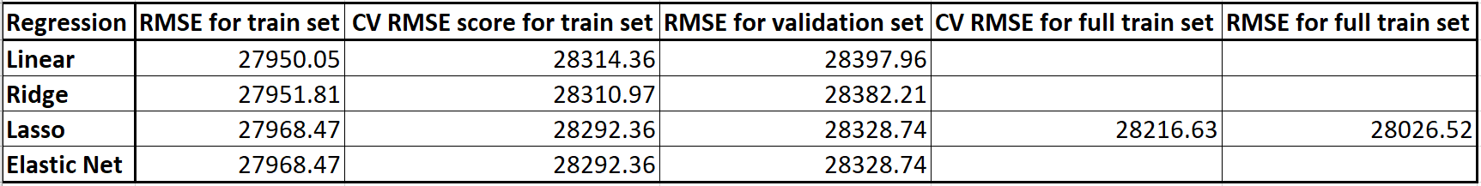
Best model for prediction
Lasso regression proves to be the best model.
RMSE: Root mean squared error
Notes:
Root mean squared error (RMSE) is the standard deviation of the residuals (prediction errors). Residuals are a measure of how far from the regression line data points are. RMSE is a measure of how spread out these residuals are. It tells you how concentrated the data is around the line of best fit. If residual is 0, RMSE is 0.
Root mean squared errors for cross validation and for residuals are similar across all 4 models. By using 5-fold cross validation, it allows to train and test the models 5 times of different subsets of training data and build up an estimate of the performance of the model on unseen data. By comparing the cross validation scores across the models, lasso and elastic net showed the same and best score. The final re-trained lasso model was used to predict the new test set and saved as a csv file under the datasets folder.

Slide 10
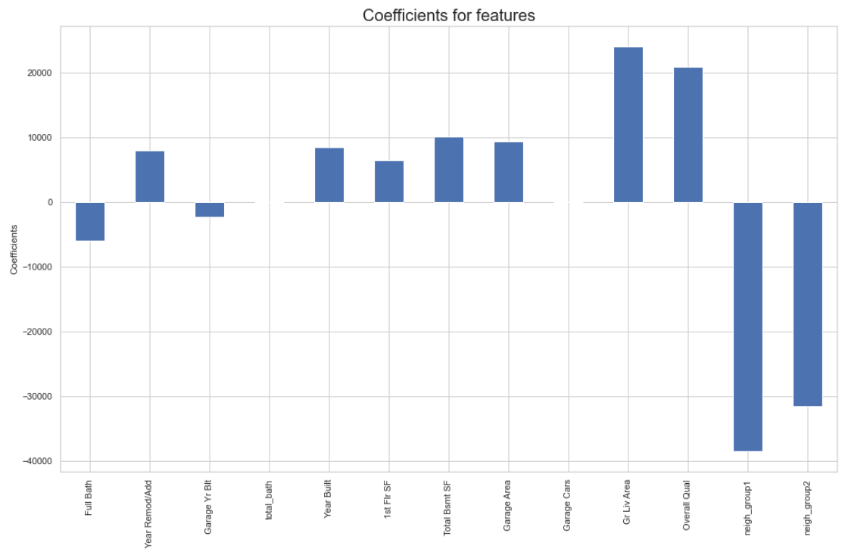
1
2
3
Sale price = -5961.6 * X1 + 7894.7 * X2 - -2362.8 * X3 + 8364.6 * X5 + 6407.8 * X6 + 10009.4 * X7 + 9276.1 * X8 + 24020.8 * X10 + 20866.4 * X11 - 38530.1 * X12 - 31538.0 * X13
Notes:
Neighborhoods were found to have the largest coefficients and hence, the greatest impact on sale price, followed by grade living area and then overall quality. The negative coefficients of numerical features may be due to their poorer correlation to sale price compared to the rest of the features. Coefficients for "neigh_group1" and "neigh_group2" are negative because they are relative to the "neigh_group3" (reference group, consisting of neighborhoods that are in the highest range of sale price). Houses in "neigh_group1" have the lowest median price and hence has the most negative coefficient of the 3 neighborhood groups. Houses in "neigh_group2" have the next lowest median price, resulting in a coefficient that is between that of "neigh_group1" and 0.

Slide 11
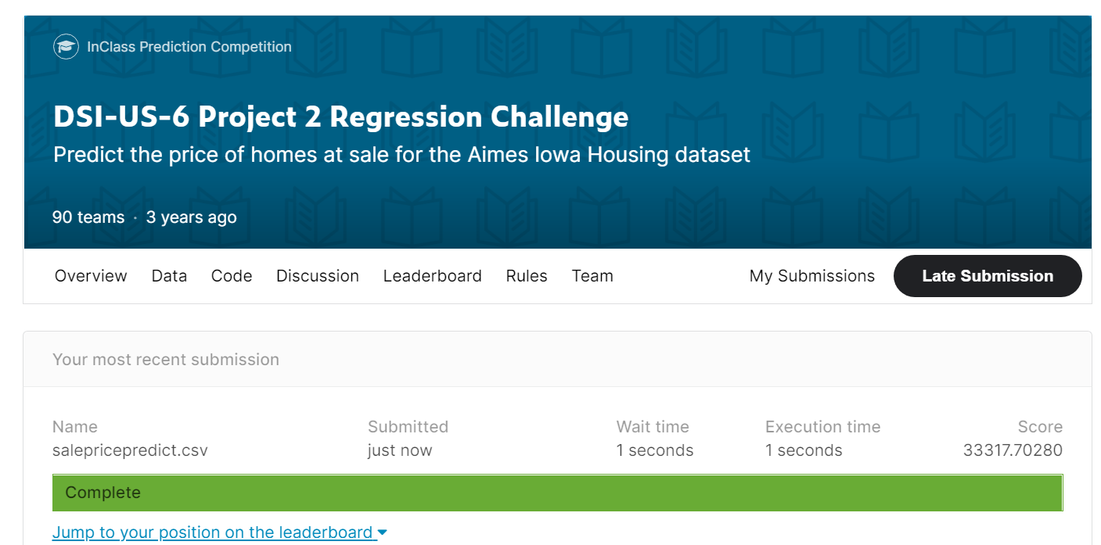
Submission to Kaggle

Slide 12
Conclusions and Limitations
RMSE for all models are similar and do not differ greatly.
Any of them can be used to understand the relationship between the features and sale price.
Best model for prediction is lasso linear regression.
Limited to houses located in neighborhoods that exist in the original training dataset.
Limited to data provided in the same format as the original training dataset, where compulsory variables are used in the model.

Slide 13
Recommendations
Focus on:
Increasing the above grade living area.
Overall materials and finish of the house.
Neighborhoods with a larger range of sale price, like NridgHt and StoneBr.
Do not focus on:
Increasing the number of bathrooms.
Increasing the number of kitchens above grade.
Increasing the area of enclosed porch.
Improve model generalisation:
Average family income
Categorise the neighborhoods according to the average family income.
Notes:
Potential sale price higher
People plan to renovate hence the existing configuration is less important

